Slide 1

American Express
Predicting Customer Attrition and Portfolio Optimization
Monique Roberts
Senior Risk Analyst

Slide 2

Agenda
Executive Overview and Role Overview
Customer Segmentation and Retention Analysis – Excel
Customer Behavior and Attrition Insights – Tableau
Portfolio Risk and Customer Health – Power BI
Key Recommendations and Business Impact
Notes:
Today I’ll be walking through a customer segmentation and retention analysis, focused on identifying key drivers of customer attrition and opportunities to improve engagement.
The goal of this analysis is to understand which customer groups are most at risk and how we can use data to support better decision-making.

Slide 3

Senior Analyst, Credit Risk and Customer Insights
Identify high-risk customer segments and analyze attrition patterns
Evaluate customer behavior using inactivity, demographics, and engagement metrics
Monitor portfolio health through spending trends and relationship depth
Deliver data-driven recommendations to improve retention and customer lifetime value
Maintain audit-ready documentation to support governance and compliance review
Notes:
From a business perspective, I’m approaching this as a Senior Analyst within a credit risk and customer insights function.
My role focuses on identifying high-risk customer segments, analyzing behavioral patterns, and providing data-driven recommendations to reduce attrition and improve overall customer value.

Slide 4

Dataset includes 10,000+ customers
Focus on attrition, inactivity, and customer behavior
Insights developed using Excel and Tableau dashboards
Goal: Identify drivers of churn and improve retention
Analysis Overview

Slide 5
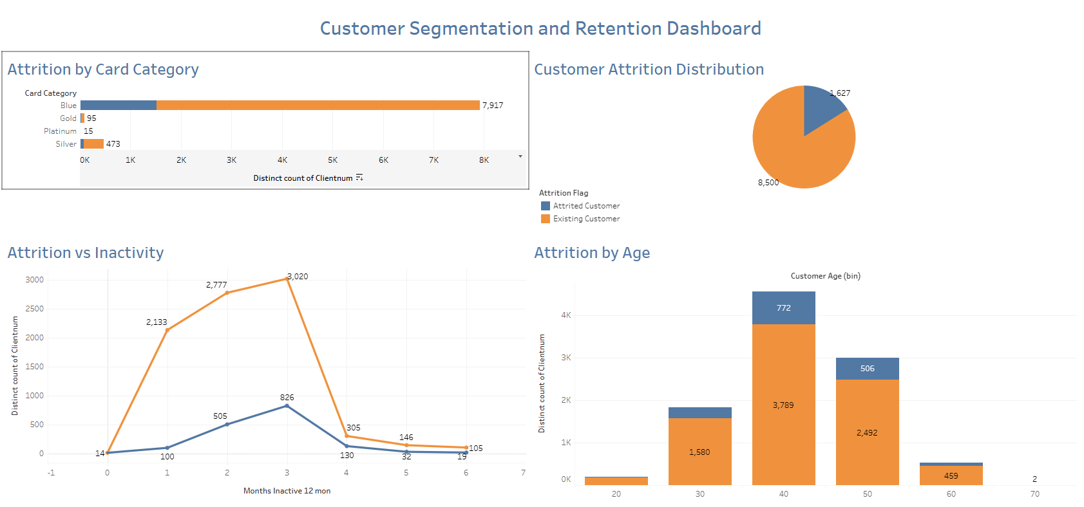
Tableau Dashboard Analysis
Attrition increases significantly after 2–3 months of inactivity
Mid-age customer segments (35–54) represent the highest attrition risk
Card category analysis confirms higher churn concentration in standard-tier products
Recommended action: Implement early engagement strategies and proactive outreach
Notes:
This dashboard highlights key behavioral drivers of attrition.
We see that churn risk increases significantly after two to three months of inactivity.
Mid-age customer segments also show higher attrition levels, and card category analysis reinforces that lower-tier products carry more risk.
This suggests that early engagement and proactive outreach are critical to reducing churn.

Slide 6

Customer behavior signals provide early indicators of attrition risk. Identifying these patterns enables proactive engagement and stronger retention outcomes.
Customer Retention Insight

Slide 7

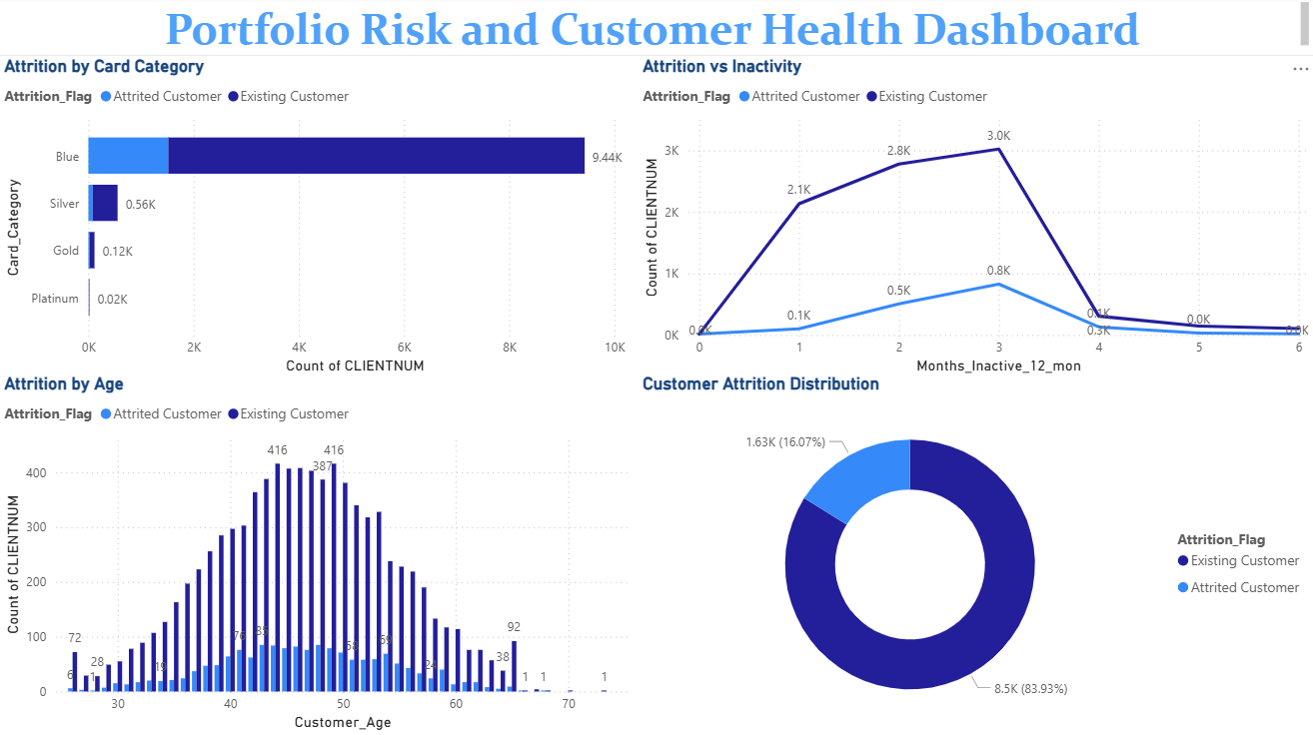
Power BI Dashboard Analysis
Customer inactivity is a key early warning signal for churn risk
Attrition patterns vary by card category and engagement level
Spending behavior and utilization help identify customer risk tiers
Dashboard supports ongoing monitoring of portfolio health and retention risk

Slide 8
Excel Dashboard Analysis
16% baseline attrition rate, confirmed by pivot-table segmentation across the 10,000-plus account portfolio
Built pivot-table segmentation across more than 10,000 customer accounts to isolate attrition drivers
Defined the inactivity, card tier, and engagement KPI logic that fed directly into the Tableau and Power BI builds
Documented each calculation step so the analysis is reproducible and audit ready

Slide 9
Recommendations
Proactive Retention Strategy
Target customers showing 2–3 months of inactivity
Launch early intervention campaigns before churn occurs
Continuous Monitoring and Early Warning System
Implement dashboards to track inactivity and engagement trends
Flag high-risk customers in real time for proactive outreach
Segment Based Customer Engagement
Prioritize mid-age customer segments with higher attrition risk
Data Driven Decisions
Use ongoing analytics to refine retention strategies
Align business decisions with customer behavior insights
Product and Card Tier Optimization
Strengthen value proposition for standard-tier (Blue) cardholders
Introduce incentives and upgrades to increase retention
Predictive Risk Modeling
Use predictive analytics to identify high-risk customers earlier
Maintain audit-ready model governance and documentation to support compliance review

Slide 10

Key Takeaway
Attrition is predictable and preventable. Customers with 2 to 3 months of inactivity, standard-tier cardholders, and mid-age segments carry the highest risk, pointing to targeted interventions over broad, costly retention spend.
Pairing this model with continuous monitoring and audit-ready reporting gives the business a retention strategy it can stand behind.
Monique Roberts
monique3roberts@gmail.com

